Slide 1
Santa Barbara County!
@ArtsInfoGuy
#AEP5
Notes:
AEP5 changes the conversation about the arts from that of a “charity” to one about an “investment in an industry” that provides both cultural and economic benefits to the community.
We’ve heard this story many times since we published our first economic impact study in 1994—probably why the number of study areas has grown from 33 in that first study to 341 in AEP5. And, why in our national surveys of LAA leaders, economic impact remains the #1 case making argument for arts funding.
We must always remember the fundamental benefits of the arts. They inspire, delight, and unite us. Art is a fundamental component of our humanity. I want to stipulate those benefits and challenge you to think of the arts as an industry—one that supports jobs, generates govt. revenue, and is a cornerstone to tourism.
“How can a group of arts organizations stimulate the economy?” (Tell a personal arts spending story that demonstrates how many industries benefit from arts spending.)

Slide 2
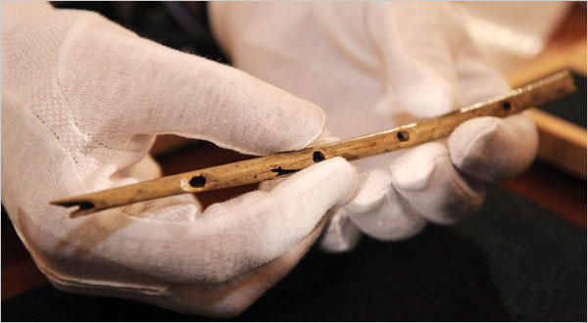
Stone-Aged Flute

Slide 3
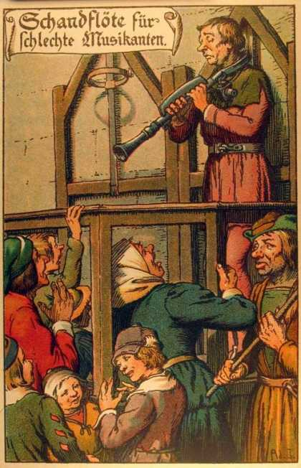
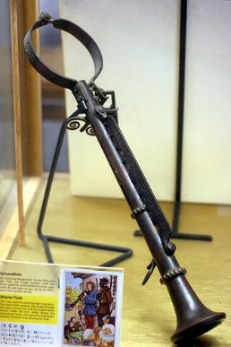
The Shame Flute

Slide 4
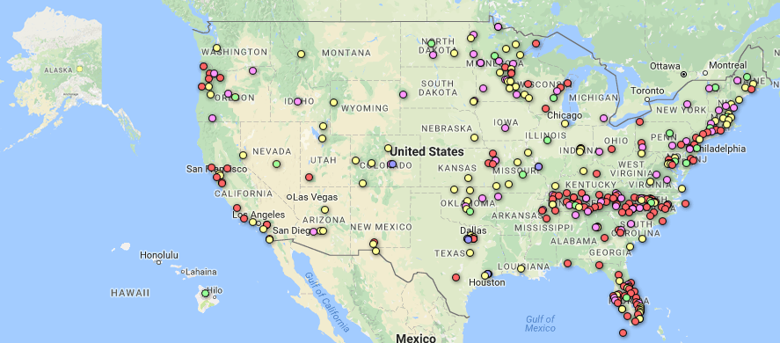
Most Comprehensive Study Ever!
341 Study Regions in all 50 States—including Santa Barbara County!
Notes:
AEP5 is our 5th economic impact study of spending by nonprofit arts and cultural organizations and their audiences. It is the largest and most comprehensive of its kind ever conducted: 341 study regions in all 50 states + D.C., small rural to large urban, populations ranging from 1,540 to 4 million. Even in our smallest communities, the arts have a measurable economic impact.
Only nonprofit and municipal arts and cultural organizations are included—no entertainment, Broadway, or motion picture businesses; no individual artists (all vital to the cultural ecology, but beyond the scope of the study).
Why just nonprofits? Because government and philanthropic dollars are typically directed to these organizations. It is appropriate to ask, “Beyond quality of life, what is the ROI of that investment?”
Conservative and Reliable Methodology . . .
For our local studies, we only include data from organizations that provide it. We make no local estimates for non-respondents. (14,439 organizations surveyed nationally.)
We do a major over-sample of audience interviews and conduct them at a diverse range of events (performing arts, museums, free open air festivals). (212,691 surveyed nationally.)
We study how a dollar ripples through the local economy. Our Georgia Tech economists customized an input/output model for all 341 study regions. This enables economists to track how many times a dollar is “respent” within the local economy, and thus to measure the economic impact generated by each round of spending. For example, when a theater company purchases paint from the local hardware store, that has a measurable economic effect. However, the economic benefits typically don’t end there, because the hardware store uses some of its income to pay the clerk that sold the paint as well as to pay its utility bill and other expenses. The clerk may use some of those dollars to pay the grocery bill, and so on. Each round of spending and its impact is measured. (Input/output models have been the basis of 2 Nobel Prizes in Economics. The AEP methodology has been vetted by the White House Council of Economic Advisors and bank economists among others.)
Because of the large and diverse number of local study regions, we can make national estimates of the economic impact of nonprofit and municipal arts and cultural organizations and their audiences. (NOTE: the national figures are NOT calculated by simply adding participating partner data. See report for details.)

Slide 5
$198.6 Million in Spending (2015)
Notes:
Total economic activity. Composed of two figures—spending by nonprofit arts and cultural organizations and the event-related spending by their audiences. This is an increase from $135 billion in 2010
Nonprofit arts and cultural organizations spent an estimated $63.8 billion in 2015. This is a myth buster for people. Sure, we appreciate the beauty of the arts, but most folks don’t realize that these are businesses. They employ people locally, purchase goods and services within the community, are members of the Chamber of Commerce, and involved in the marketing and promotion of their regions. Arts organizations are good business citizens.
What is the economic impact of that spending?

Slide 6
Jobs Supported (FTE)
5,857
Notes:
Arts organizations employ more than just artists, curators, and musicians. They also pay builders, plumbers, accountants, printers, and occupations spanning many industries.
Remember that our economic analysis measures jobs supported throughout the community.
Because arts organizations are strongly rooted in their community, these are jobs that necessarily remain local and cannot be shipped overseas. (Even in a global economy, arts remain local employers)
Arts . . . Not just food for the soul, but putting food on the table for 4.6 million households

Slide 7
Government Revenue
(Local & State)
$19.1 Million
Notes:
Government receives an estimated $27.5 billion in revenue every year as a result of the economic activity of nonprofit arts organizations and their audiences.
This is an outstanding yield given that their collective outlay is about $5 billion. Small Investment. Big return.
Currently there are threats against nonprofits because of the mistaken assumption that they only take, but don’t give back. This study shows that beyond their public benefit, there is also a significant economic return as a result of their investment. Arts funding to nonprofits is not a one-way street.

Slide 8
Attendees Spent
$28.25 Per Person, Per Event
Notes:
LIKE all industries, spending by arts organizations has a measurable economic impact. UNLIKE most industries, the arts generate a bounty of event-related spending for local businesses—dollars that land in the pockets of local business establishments such as parking garages, restaurants, retail stores, hotels, and even the local babysitters.
We did 212,691 audience surveys. This is what the average spending looks like.
Can you still get a room for $4.48?? (Remember, these are averages)
When you interview 212,000 people, you are going to hear some great stories. My favorite in the “Other” category is a farmer who paid someone $60 to milk his cows so he could go to the theater.

Slide 9
Audiences: Local vs. Non-Local
Notes:
In addition to spending information, all 212,691 attendees also provided their zip code so we could determine whether they live IN the county in which the arts event takes place (local) or outside the county (non-local).
Nationally, 34 percent of arts attendees come from outside of the county that they live in (up from 32 percent in 2010).
Does their spending differ from local attendees . . .?

Slide 10
Event-Related Spending
Local vs. Non-Local
57 percent of non-local attendees said, “This arts event is the primary purpose for my trip.”
Notes:
Nonlocal attendees spend $47.57 per person, per event, not including admission—more than twice as much as their local counterparts.
We asked non-local attendees, “Why are you here?” 69 percent said, “This arts event is the primary purpose for my trip.”
We asked local attendees about what they would have done if the arts event that they were attending was not taking place: 41 percent said they would have “traveled to a different community to attend a similar arts event.”
Of the 34 percent of arts attendees who are nonresidents, Nationally, 14 percent reported an overnight lodging expense. They average $169.06 per person. When you can get those “heads in beds,” that is when the cash registers start to ring.
These data show the power of the arts draw visitors into their community, and these people spend money. It also shows that the arts keep locals and their discretionary spending in the community. That is why we say a vibrant arts community is good for local businesses. (Putting “cheeks in seats” and “derrieres in café chairs” ☺.)
(For this analysis, only one night of lodging expenses is counted toward the audience expenditure, regardless of how many nights these cultural tourists actually stayed in the community. This conservative approach ensures that the audience-spending figures are not inflated by non-arts-related spending.)

Slide 11
Arts Volunteerism
6,927 volunteers
328,000 hours
$7.7 million value
(2015 volunteer hour = $23.56)
Notes:
While arts volunteers may not have an economic impact as defined in this study, they clearly have an enormous impact by helping arts organizations function as a viable industry.

Slide 12
AEP5 National Partners
Notes:
AEP5 National Partners are organizations of public and private sector leaders that steer billions of dollars in public and private sector arts funding and create arts-friendly policies. They are partners because, (1) they too believe the arts are a fundamental component of a healthy community, and (2) they approve of the methodology and findings. Their logos are on the back cover of every AEP5 report. This boost your credibility when advocating with the data.
Be sure your mayor knows the U.S. Conference of Mayors and National League of Cites are partners.
Be sure your city manager know that International City/County Management Association is a partner.
Be sure your business leaders know that the Conference Board and Committee encouraging Corporate Philanthropy are partners.
Be sure your private funders know that Council on Foundations and Independent Sector are partners.
Be sure your tourism and economic development people know that Destinations International and National Alliance of community Economic Development Associations are partners.
In a 2017 National League of Cities report about key issues facing city leaders, “Economic Development” tops the list at #1. Within economic development, “Arts and Culture” are listed among just five core subject areas along with jobs, business attraction, and downtown development. (“State of the Cities 2017”: http://www.nlc.org)
A 2017 AFTA Business Committee for the Arts Survey, conducted with the Conference Board, showed that 67 percent of businesses that support the arts do so because it improves the economy and quality of life. (http://www.americansforthearts.org/events/bca-10)

Slide 13
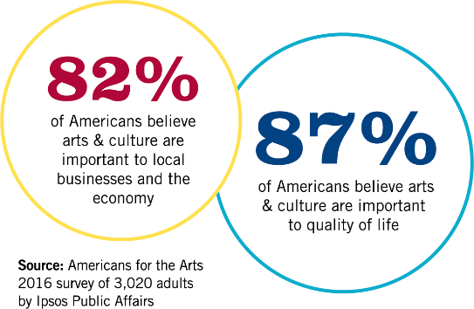
Americans Value The Arts
Notes:
Our community leaders are not the only ones who appreciate the quality of life AND economic value of the arts.
The American public values this as well:
87 percent believe they are important to quality of life.
An impressive 82 percent also believe the arts are important to local businesses and the economy.

Slide 14
Creative Santa Barbara County
1,322 Arts-Related Business Employ 4,649 People
5.3% of all businesses
2.0% of all employees

Slide 15
All U.S. Arts Industries (2014)
$730 Billion = 4.2 Percent of GDP
Source: U.S. Bureau of Economic Analysis
Notes:
Adding more gravitas to the economic impact of the arts argument . . . the U.S. Bureau of Economic Analysis (BEA) established the Arts & Cultural Production Satellite Account, which takes into account the full breadth of the nation’s art and culture industries. That is, not just the nonprofit sector (like AEP5), but also the commercial and entertainment sectors, individual artists, Broadway, motion picture industry, architecture and design, university education programs, etc.
According to BEA, the arts were a $730 billion industry in 2014, which represents 4.2 percent of the nation’s Gross Domestic Product—a larger share of the economy than transportation, tourism, agriculture, and construction.
AEP5, by contrast, analyzes only nonprofit and municipal arts and cultural organizations. A second key distinction is that AEP5 is the only national study that includes an analysis of event-related spending by arts audiences.

Slide 16

Artists and Innovation

Slide 17

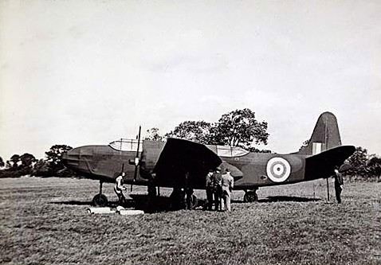
“Operation Fortitude”
Creativity in the Battlefield

Slide 18
Notes:
The 2008, the Conference Board published, Ready to Innovate touts the importance of arts education in building the 21st century workplace. Arts participation in the school or in the workplace strengthens our “creativity muscles” which builds our creativity, the fuel that drives innovation.
72% of employers say creativity is of primary concern when they’re hiring, and 85% of these employers can’t find the creative applicants they seek.
Employers who replied to the survey believe creativity has less to do with finding solutions than with the ability to spot problems or patterns others cannot see.
Arts-related study in college is a key creativity indicator to potential employers.
Very few employers test for creativity in the hiring process; a noteworthy 27 percent said they use the candidate’s appearance to assess creative ability.
The Conference Board report concludes, “..The arts—music creative writing, drawing, dance—provide the skills sought by employers of the Third Millennium.

Slide 19

Thomas Südhof
2013 Nobel Prize for medicine:
“I owe it all to my bassoon teacher”
Drive for excellence…visual thinking…pattern recognition…problem solving…perseverance

Slide 20

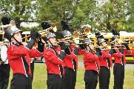

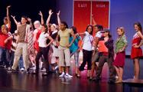
Improved Academic Performance
Notes:
CATTERALL . . .
The academic benefits of arts education go beyond math and reading. An analysis of U.S. Department of Education data by UCLA research James Catterall found that students who were highly involved in the arts performed better on a variety of academic measures than other students (grade point averages, standardized test score, lower drop-out rates, and better attitudes about community service . . . these findings also held when studied across socio-economic strata, suggesting that the arts can "level the playing field" for youngsters from disadvantaged circumstances.
Don’t take my word for it. In a recent commentary in Education Week by Arkansas Governor Mike Huckabee and former U.S. Secretary of Education Rod Paige, they write, “The arts instill in students the habits of mind that last a lifetime: critical-analysis skills, ability to deal with ambiguity and to solve problems, perseverance, and a drive for excellence.”
Now, it's hard to argue with these facts, but policy makers have found ways to ignore them. Too many of our students in our communities and classrooms simply don't have access to arts education. Last year’s report by the Council of Basic Education documented, via surveys of 1,000 school principals, what so many of us are observing. Because of No Child Left Behind laws, our schools are teaching to the test more than ever, and cutting out the liberal arts. 25 percent of the principals reported decreases in instructional time for the arts; 33 percent anticipate future decreases in instructional time.

Slide 21
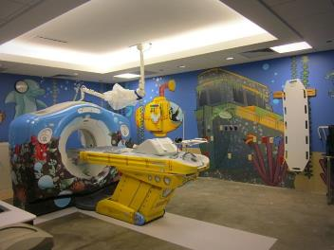
Arts in Healthcare Benefits
Reduced length of hospital stay
Fewer medical visits
Reduced use of pain and anxiety med’s
Improved recovery time
Reduced depression
Notes:
Jeff Koons installation in CAT Scan room of Advocate Children’s Hospital. New York Times.
In a national survey about arts programs in hospitals, more than half of the 2,000 responding hospitals indicated having on-site programming for their patients and staff. The reasons are many, but 73 percent present the arts because it aids in a patient’s mental and emotional recovery.
Arts programs in hospitals serve multiple audiences: 96 percent are designed to serve patients directly; 56 percent include the patient’s family members; and 55 percent include programs for staff, as a means to deal with the stress in the healthcare environment.
Hospital arts programs are largely funded by the hospital itself—66 percent of their budgets come from the hospital’s general fund. These programs are often conducted in partnership with local performing and visual arts organizations, or their local arts agency.
Survey conducted by Joint Commission on Accreditation of Healthcare Organizations, Americans for the Arts, and Society for Arts & Healthcare.

Slide 22
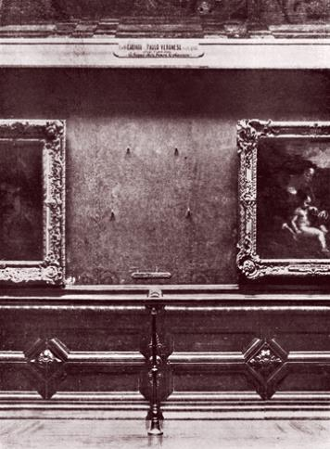
Appreciating Our Cultural Assets
Notes:
If you remember one thing about this . . .
Arts & Economic Prosperity 5 changes the conversation about the arts from a “needy charity” to one about an “investment in an industry” that provides both cultural and economic benefits.
The nonprofit arts industry generates $166.3 billion dollars of economic activity every year.
Supports 4.6 million jobs. In a global economy, the arts remain local employers.
Generates $27.5 billion in federal-state-local government revenue—an amazing yield given their $5 billion collective outlay. Small investment—big return.
If you care about quality of life and strengthening your economy—you can feel good about investing in the arts.
What do you do with an industry [$166.3 billion industry] that supports 4.6 million jobs and generates $27.5 billion in government revenue? Invest in it, nurture it, and grow it!" Support the arts!
Nationally as well as locally . . .

Slide 23
The Arts Mean Business!
AmericansForTheArts.org/AEP5
rcohen@artsusa.org

Slide 25
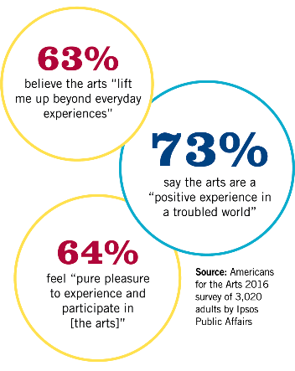
Americans Value The Arts
Notes:
The American public appreciates this value that the arts bring to their community. While 87 percent believe they are important to quality of life, an impressive 82 percent also believe the arts are important to local businesses and the economy.

Slide 26
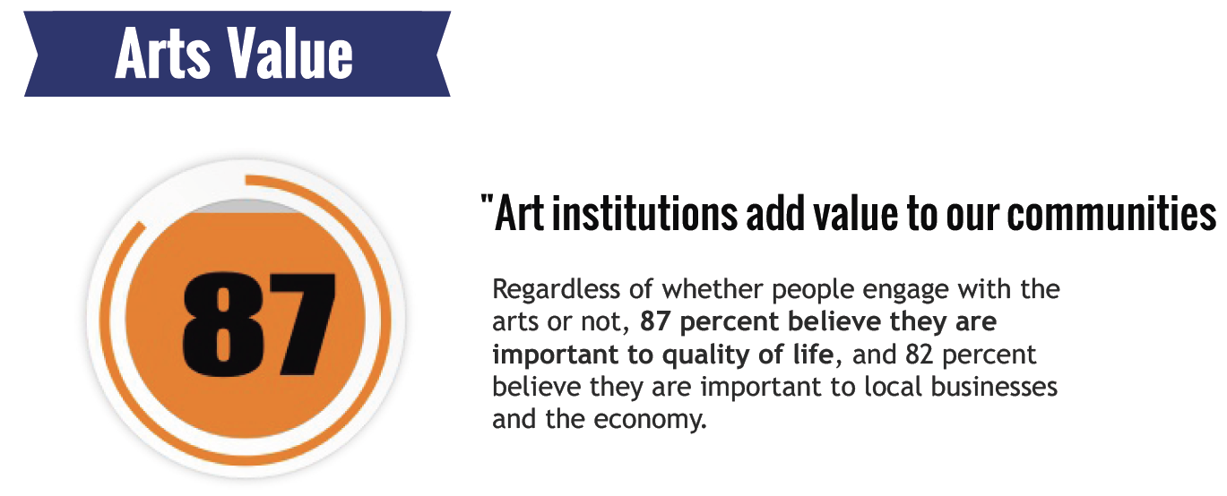
Americans Value the
Pragmatic Benefits Too!
“Tell every one of your Senators about the
economic benefits of the arts!”
-U.S. Senator Tom Udall (NM)

